Slide 1
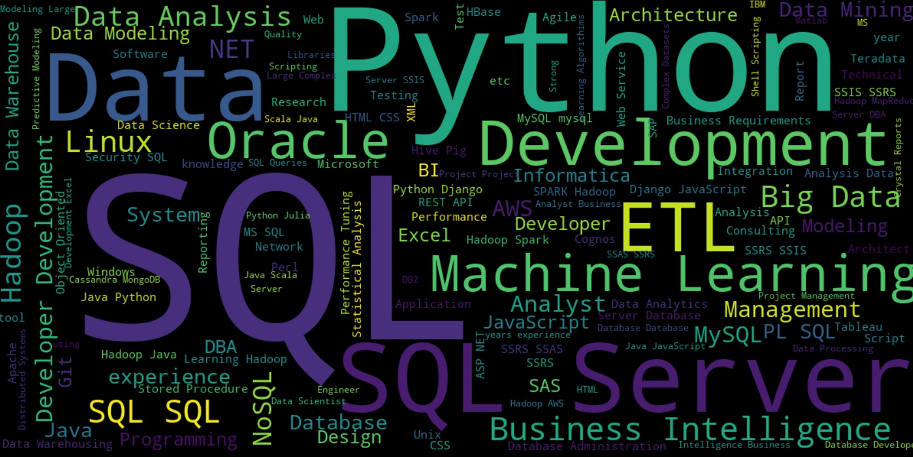
Job analytics.
*Word cloud created from the most mentioned skills and tools in Job descriptions analyzed.
Kim, Mauricio, Nish, Vivek

Slide 2


Motivation & Summary: what are our prospects after this course?
SQL
Python
Pandas
Matplotlib
APIs
Data Visualization

Slide 3
Our Questions and Hypothesis
What is the outlook for someone looking for a job in Data Analytics?
We think there’s a boom of jobs in Data Analytics in recent years.
Where are the employment opportunities for Data Analysts in the US?
Our hypothesis is that most jobs will be in the states of California and New York, specifically in cities in the Silicon Valley
What is the average salary for people looking for Data Analytics jobs
We think it’s going to be on average more than other jobs.**
What are the skills/tools most valued for Data Analytics jobs
We think most of the skills and tools learnt in this course will be the most valued.
What are the most common job titles associated with these types of jobs.
We think the most common will be Analysts and Scientists.
** No public information available

Slide 4
What data do we need? As much data as possible on jobs, salary and skills!
Job postings
Skills most valued
Companies employing people in data analytics
Whereabouts of the jobs
Salaries and pay rates for the jobs
Level of jobs
Job titles
Where to find all of this!?

Slide 5












Where did we take the data from? Turns out not a lot of APIs are public :/ but many datasets are!
Notes:
Glassdoor – closed
Linked in – recently past closed
Indeed – premium – not approved
Jobble – success but limit of 1000 records max

Slide 6


Exploration and cleanup Divide and conquer! (also, github branches are your friend – most of the time)
pd.read_csv
df.dtypes
df.describe()
pd.sort
pd.merge
pd.dropna
pd.rename()
pd.to_csv
Git pull
Git branch
Git add
Git commit
Git checkout!
Notes:
Talk about steps – Master Branch – Branch out – Applied commands to each data sets/… Criteria for the data sets.

Slide 7
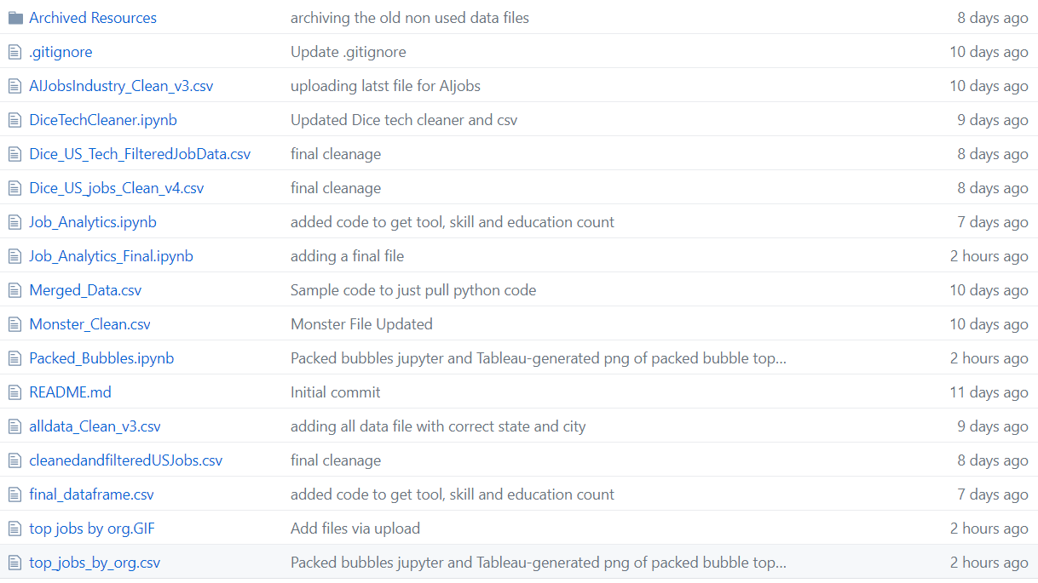
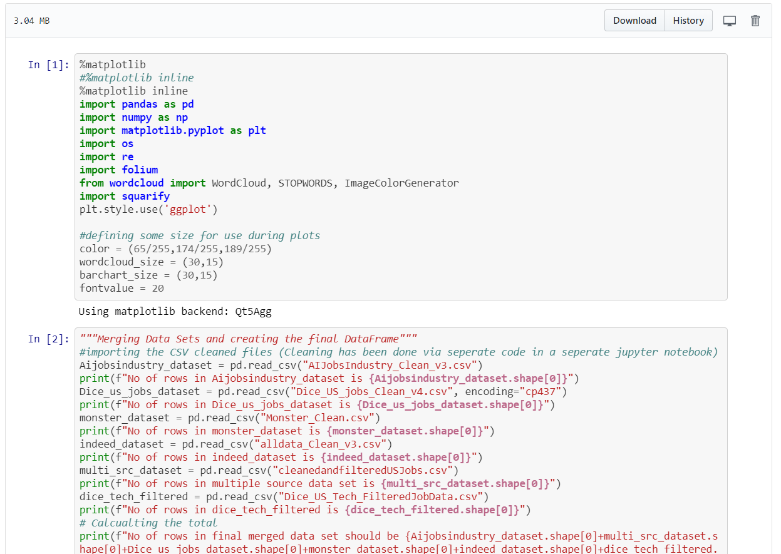
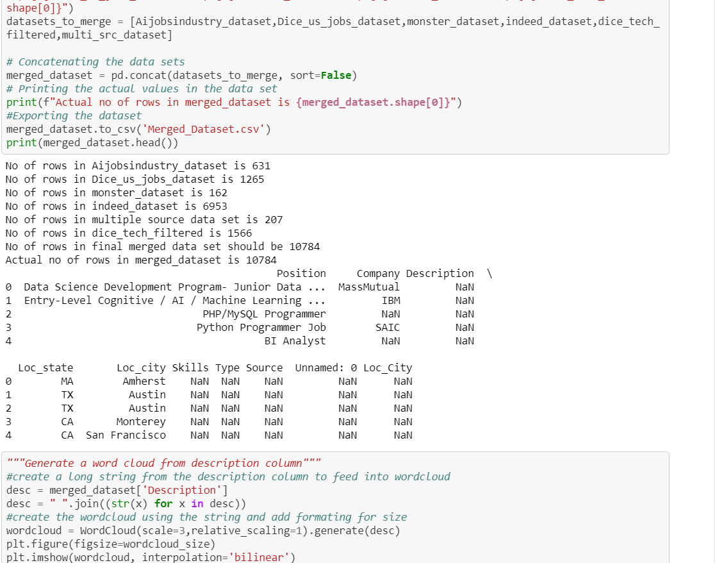
We used Jupyter and Github Always commit and comment onyour changes – a few snippets of what we did.

Slide 8
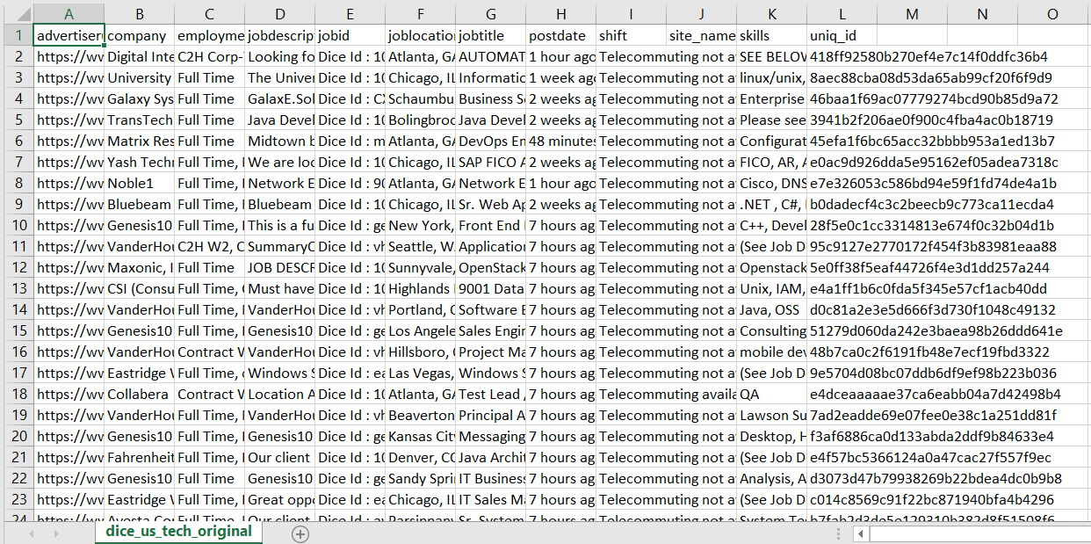
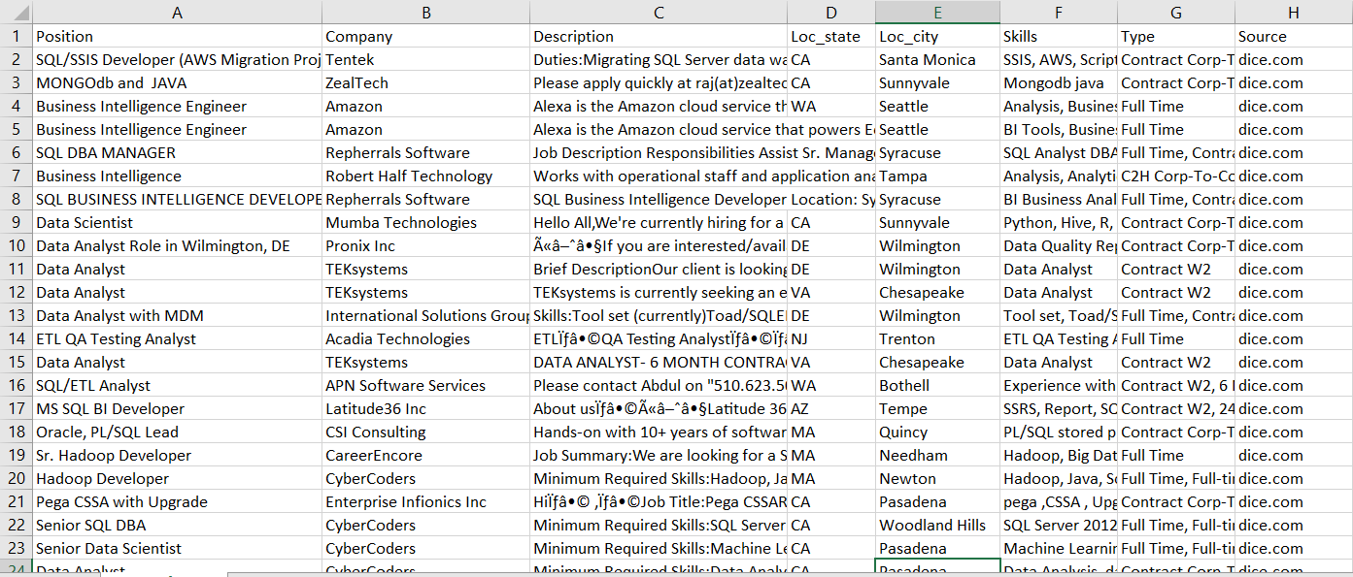
Data transformation Our final merged data had to match in columns and type of information

Slide 9
Roadblocks and Insights Assumptions are important to say out loud!
Not many public APIs or restricted access
Many datasets have irrelevant information or gibberish
Not all datasets have the same information, coded in the same way
Blanks aren’t always your enemies
You can mine data fields to extract relevant information
Sometimes you’ll have to constrain and define your own data
Write down your assumptions and remember them
If you don’t define your problem at first you’ll have trouble getting somewhere
Notes:
Lack of public API’s
Sift though many sites to get data 2016 or newer data
Format, content is diff across diff sets and sometimes irrelevant
We also noticed not all blank values are to be remove as they sometimes mean and add value to the analysis
Parse out information when its not available like tools, skills and edu from description
Assumptions like 2016 only, restrict no of data sources, based on key words in the title
Unless we have a vision of what questions we have, its easy to get distracted by the data (which is both good and bad depending on the goal of your project)

Slide 10
Our Criteria
Only datasets with job postings from 2016 or newer
Pertinent data and most current one we could find
Filter datasets with the Keywords in the Job Title that included position, skills and tools relevant to this class
The most interesting ones for us, taking this course!
Only datasets that at least had Job Title, Description and Location
To ensure we had the best information for our analysis
Only datasets for job posting in the US
We wanted to stay within the US, but there’s plenty of information for jobs all around the world!

Slide 11
Data analysis
First step – What were our original questions?
Does our data allow us to answer them?
Second Step – What other interesting questions can we answer with this data?
Is there other information that we could visualize in an interesting way?
Third Step – Divide and conquer!
Check in to collaborate as frequently as possible, teammates give perspective to your charts and are good for bouncing ideas
Fourth Step – Discuss and unify
Discussing results with teammates is much more enriching and insightful

Slide 12
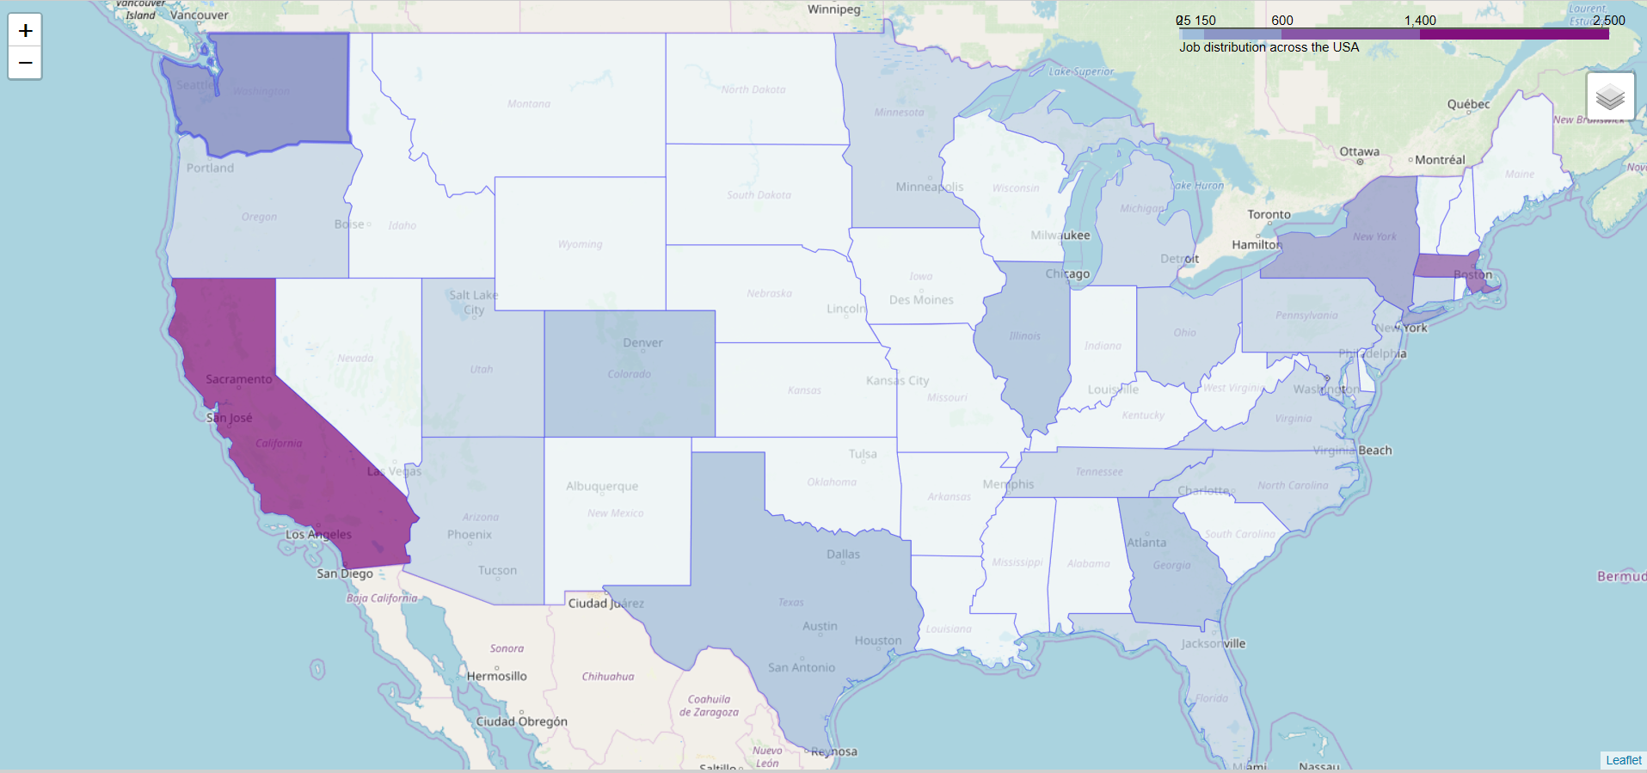
Choropleth for job postings by state Most Job postings were in California and Massachussets
Notes:
Choropleth
Follium package
Interactable
Can add numbers as you zoom but very complex and could not complete on time

Slide 13
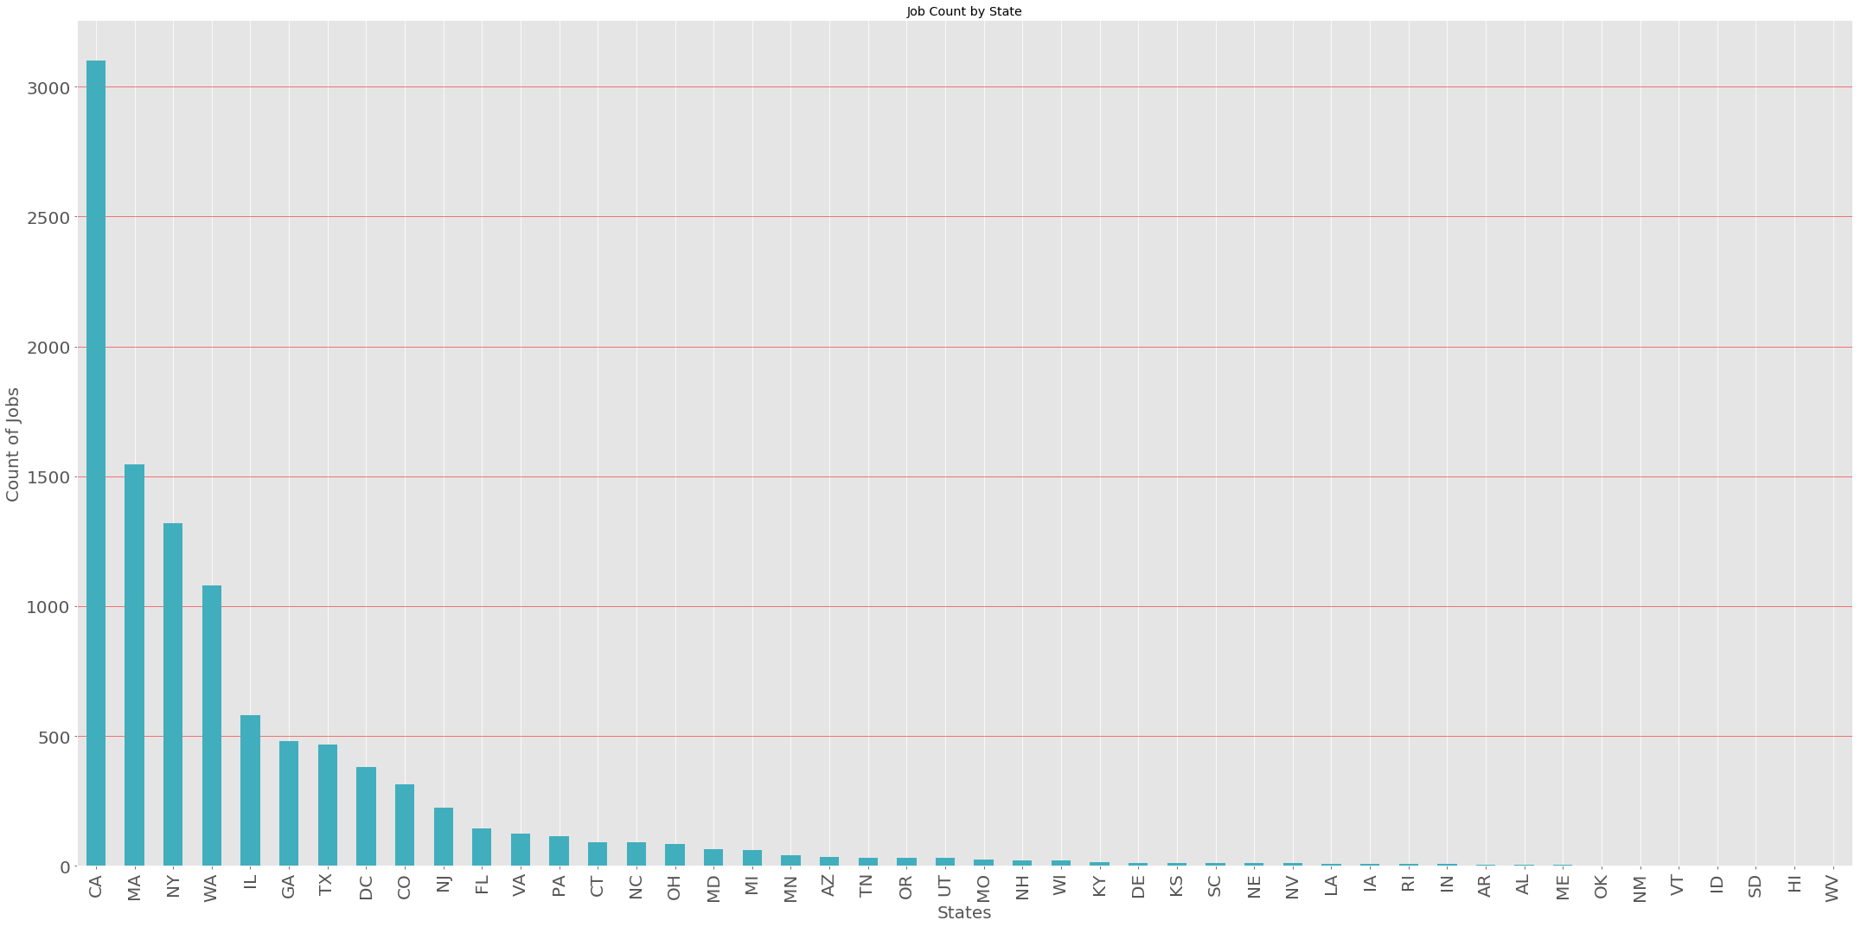
Job count per State IL, WA, NY, MA and CA are the states with the most job postings!

Slide 14
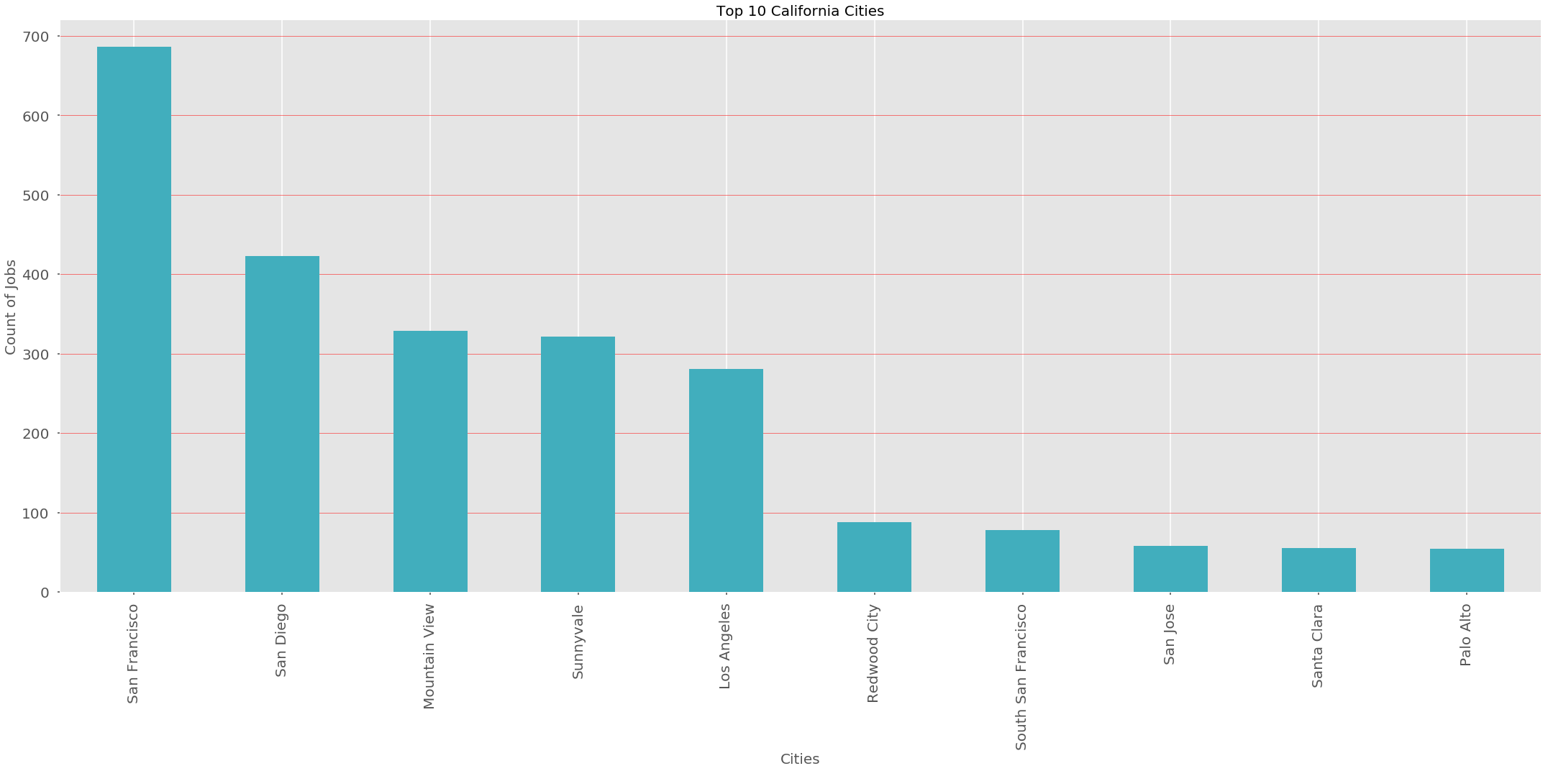
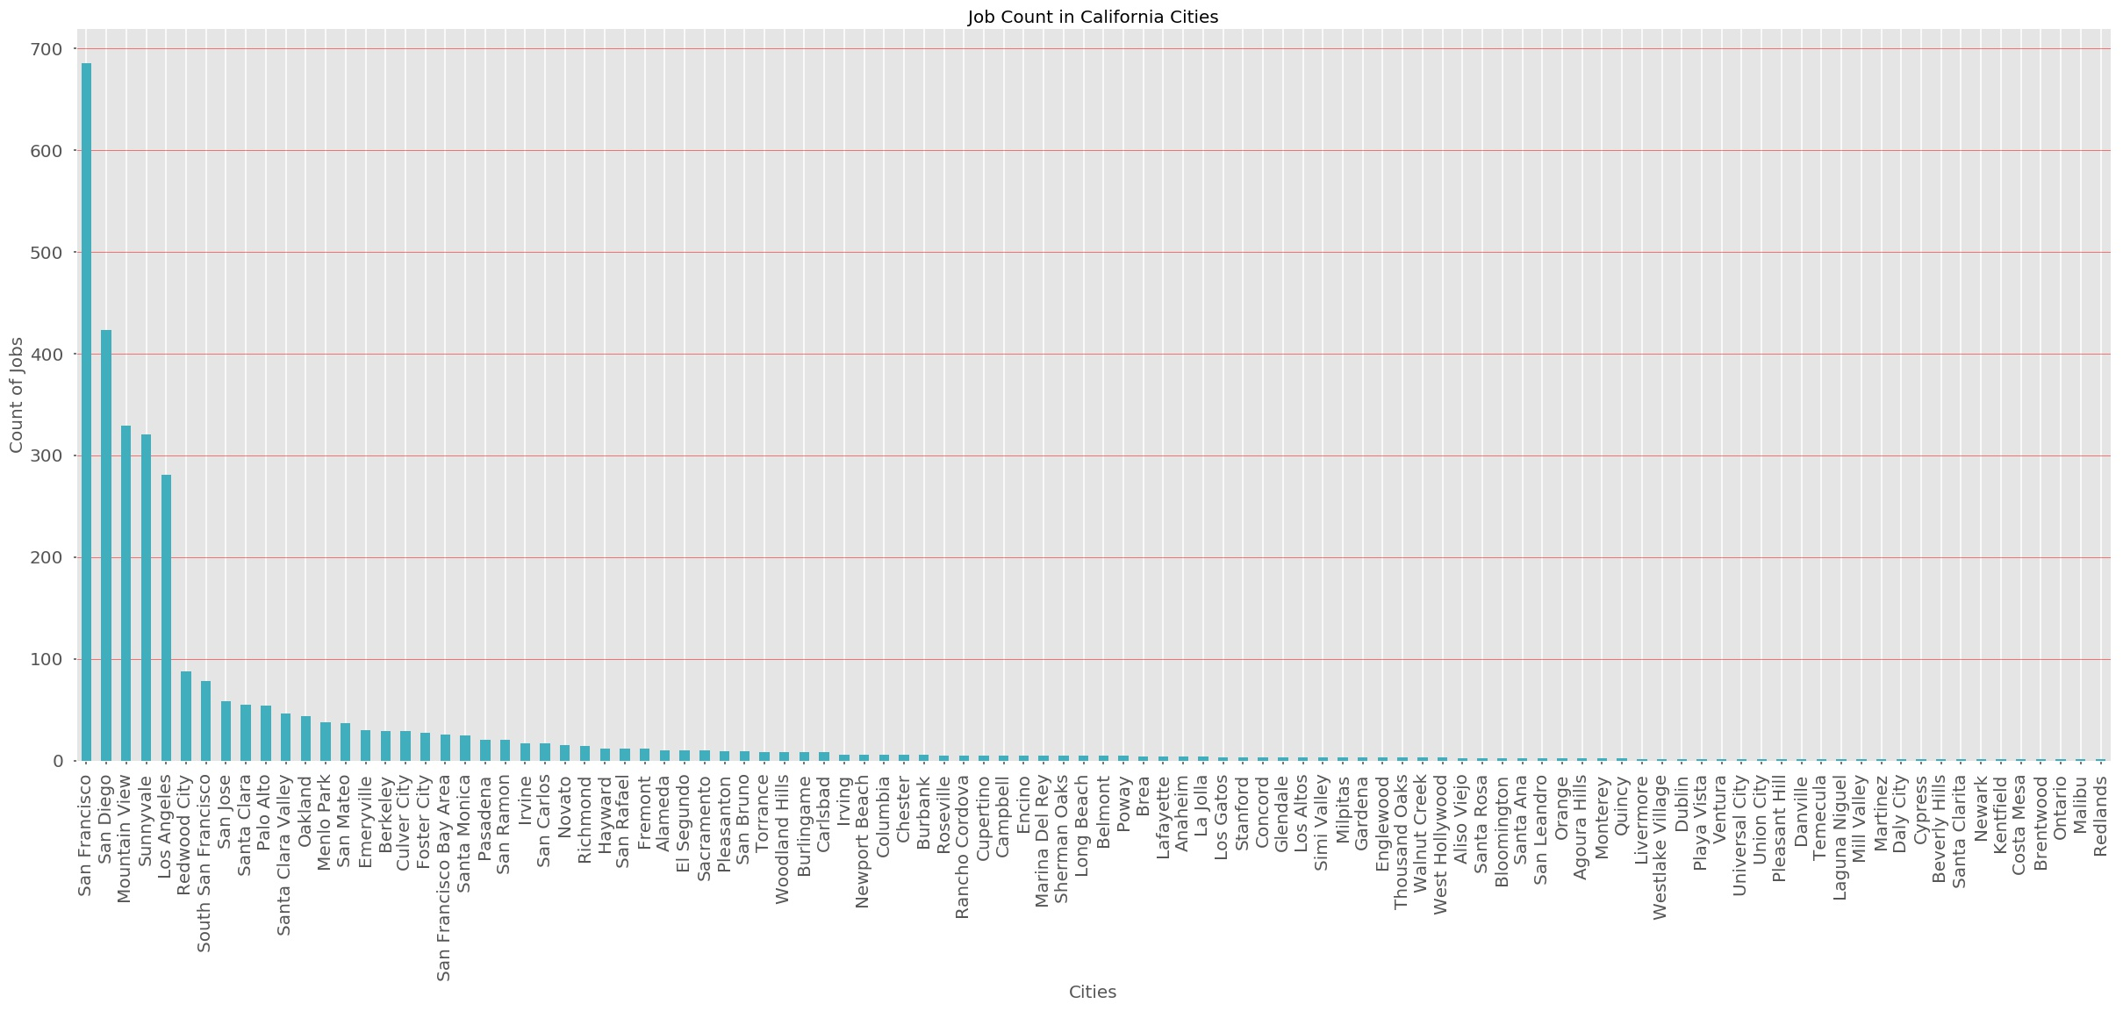
Job count in California cities– Bar graph In California the most jobs are located in the bay area!

Slide 15
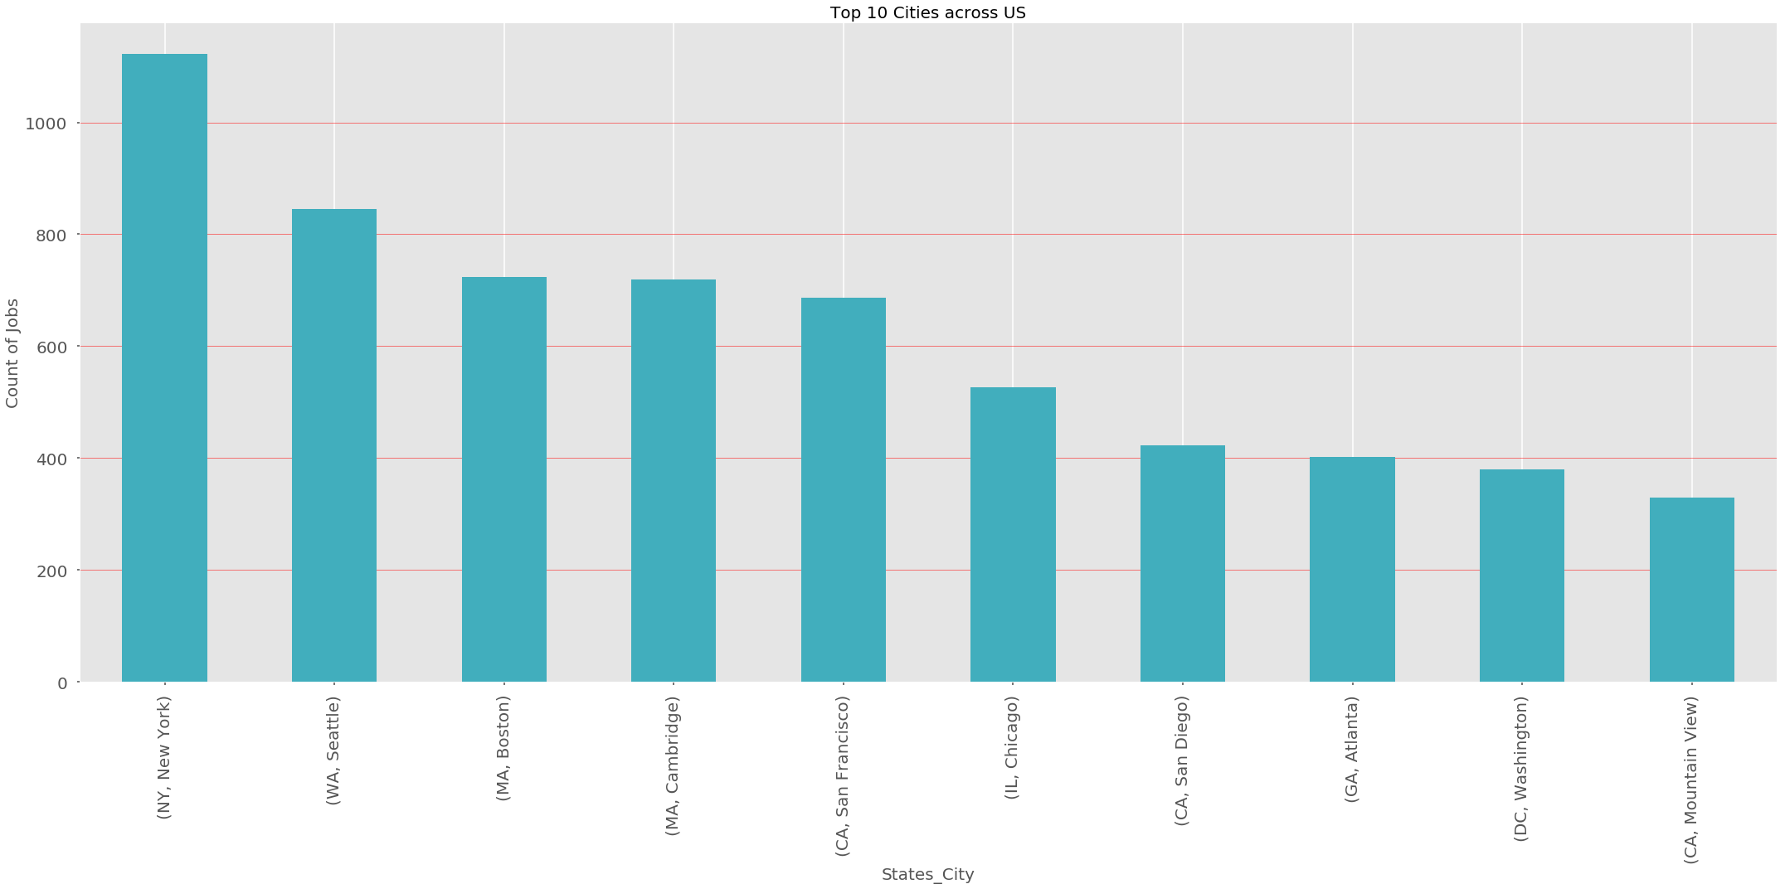
Job count in US Cities If looking outside CA, New York, Seattle, Boston and Cambridge are good options!

Slide 16
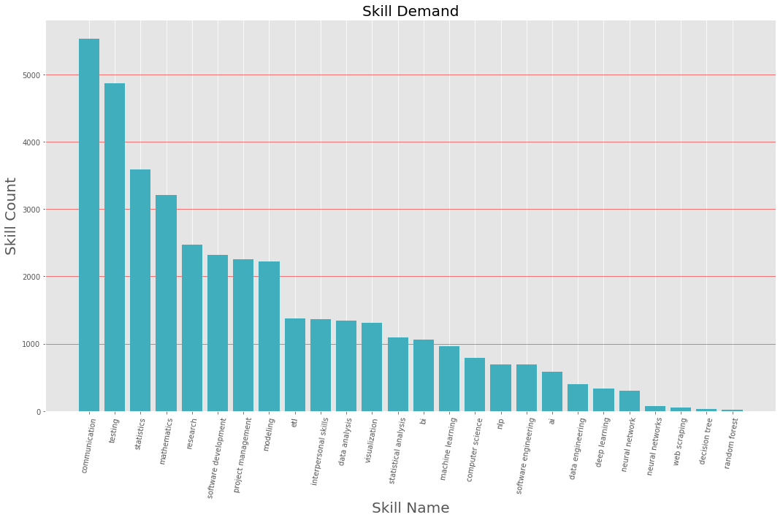
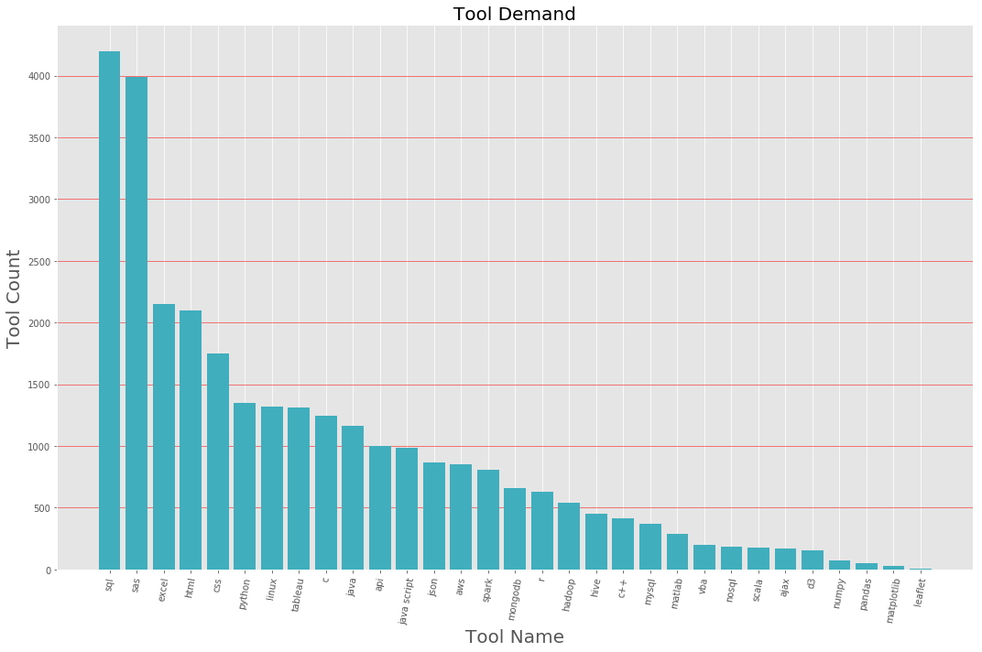
Skill and tool demand by job posting All of what we learn in this course is very useful!
Notes:
Be careful not to count skills multiple times
Interesting findings

Slide 17
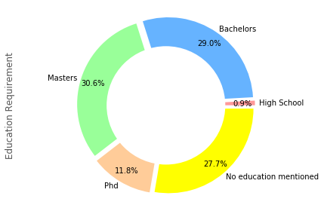
Education requirements by job posting A lot of jobs still require formal education – in the most part
Notes:
Ensure we count no mentions for no education mentioned

Slide 18
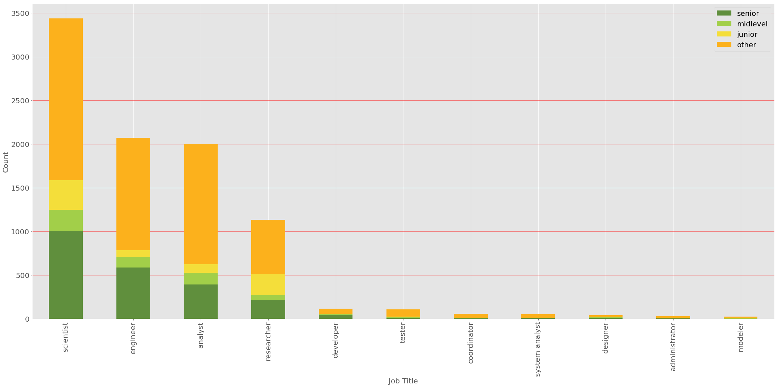
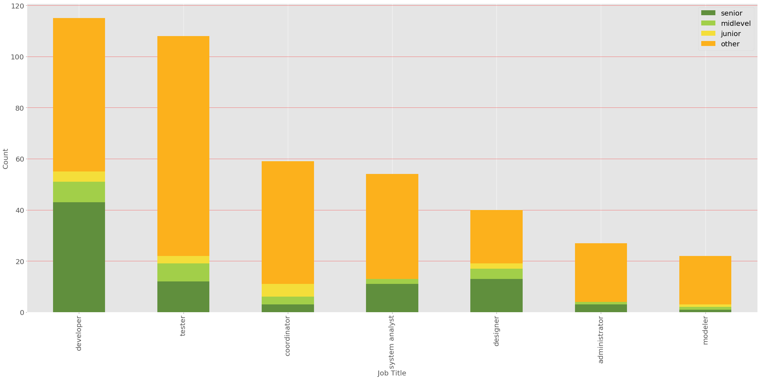
Common Job Titles/levels for Data job postings Senior level analysts, engineers and scientists are the most wanted!

Slide 19
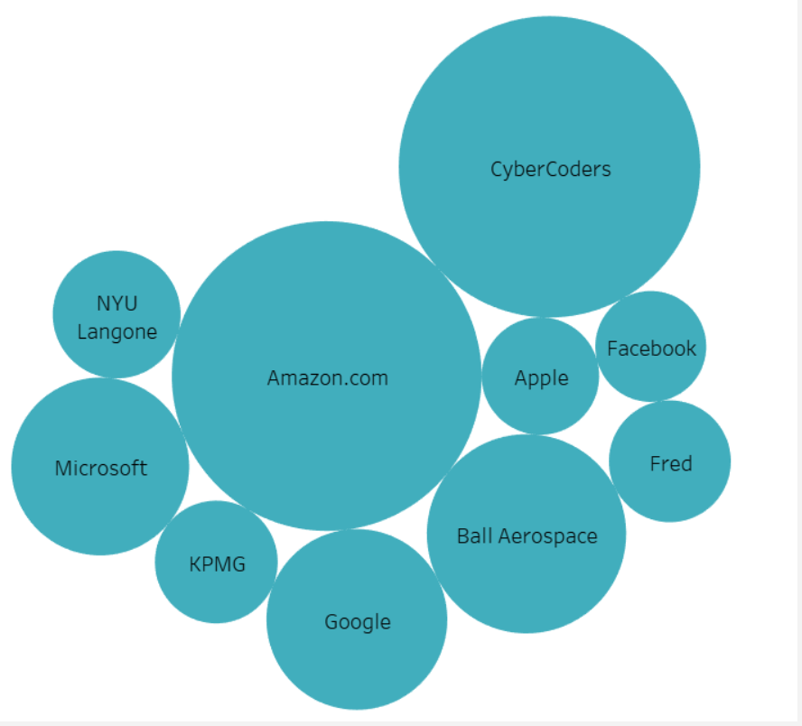
Top 10 companies hiring for these types of jobs

Slide 20
Discussion A couple of expected findings, and a few unexpected ones
Most job postings for Data Scientists, analysts and engineers are based in California (as Expected)
There’s a decent amount of data analysis jobs in Massachusetts (Unexpected)
The skillset we’re learning here comprises a lot of what employers are looking for in the job market (as Expected)
SAS is a very coveted tool (Unexpected)
Formal education is very valued by employers (we hadn’t even thought about this!)
There are more senior job openings than mid and junior levels (Unexpected)
Notes:
Data scientist, data analytics mis-nomer
Most jobs are in the silicon valley
Surprisingly MA had a lot of jobs
Skills from this course are very relevant to the job market – so alex, you are taking us on the right track
SAS - is an American multinational developer of analytics software based in North Carolina. The company is the world's largest privately held software business.
Formal education is expected in most job listings
More openings for sr that jnr
'High School':edu_count['high school'],
'Bachelors':edu_count['bachelors']+edu_count['bachelor']+edu_count['graduation']+edu_count['bs']++edu_count['ba'],
'Masters':edu_count['masters']+edu_count['master']+edu_count['post graduation']+edu_count['ms']++edu_count['ma'],
'Phd':edu_count['phd'],
'No education mentioned':no_edu_count

Slide 21
Post Mortem
Our main difficulty starting out – Unavailable public APIs with the right information.
We didn’t give up! We scraped everywhere we could look until we found a combination of datasets that looked promising.
Sometimes you won’t be able to answer all the questions you started out with, but some other interesting ones might pop up!
We couldn’t find the information for salaries we wanted, but we found some about skills, tools and education we hadn’t thought about!
It’s easy to get stuck when your graph or analysis isn’t what you expected
Bouncing your ideas off of other people helps put things in different perspectives

Slide 22
Post Mortem
We would love to get a go (and an answer!) from Google jobs, we’re sure their data is bigger and better! – Viv is meeting with them this Friday!
We also would love to get our hands in the Glassdoor and Indeed APIs, but for that to happen we need to be API Partners (look it up, it’s a thing :o!) – Creating our own dataset, with more up to date information
We would love to compare the different job portals and see if there’s a preference for types of jobs posted in one vs another (Analysts with Python in Linkedin vs Analysts with Hadoop in Indeed)
Develop an algorithm capable of deleting duplicates of jobpostings across different portals

Slide 23
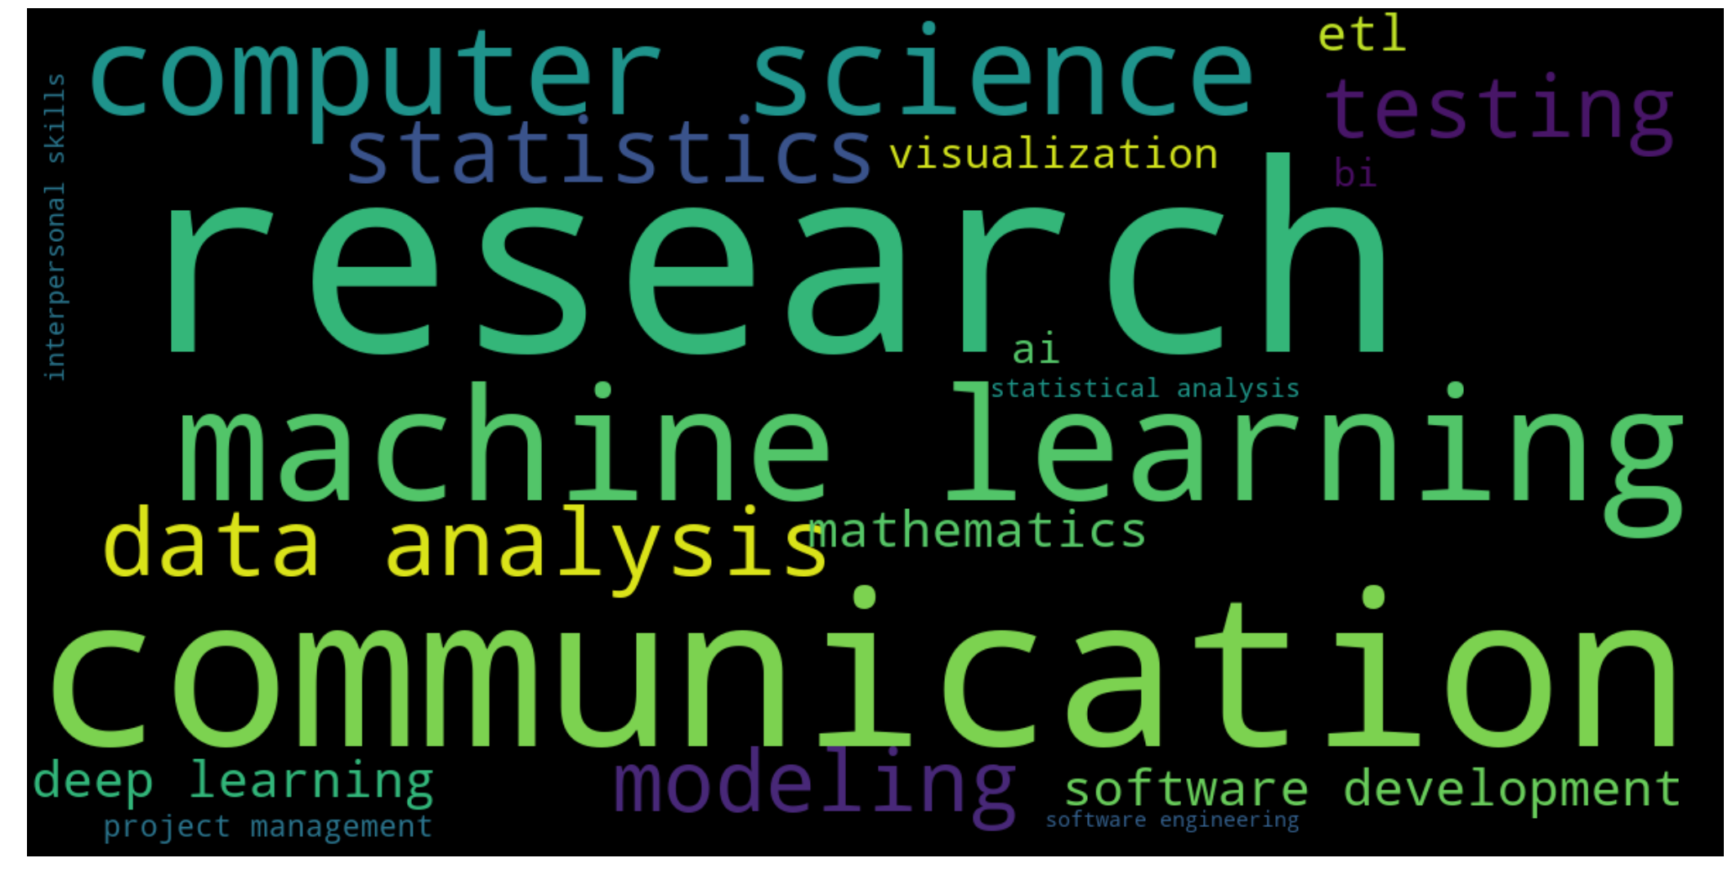
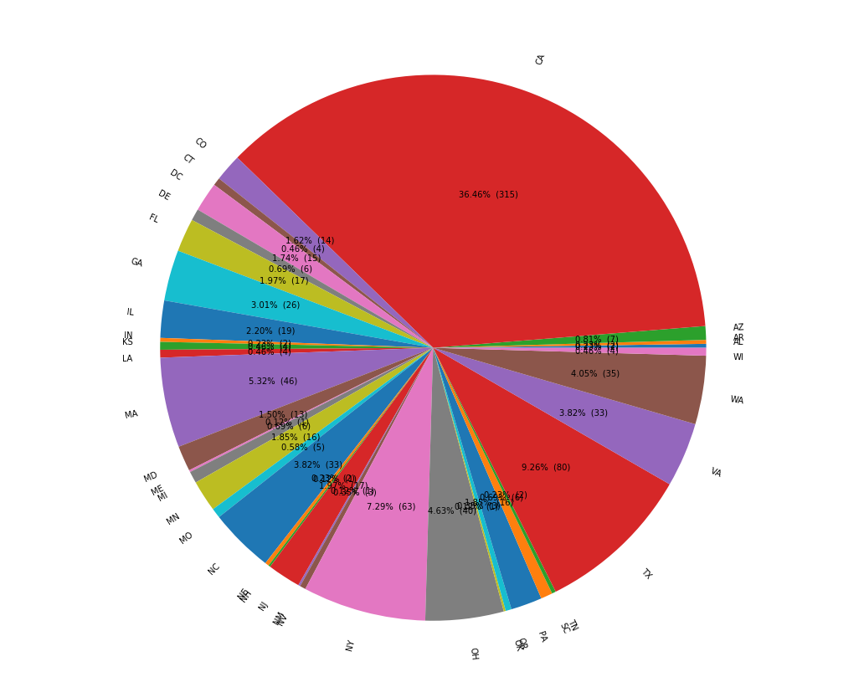
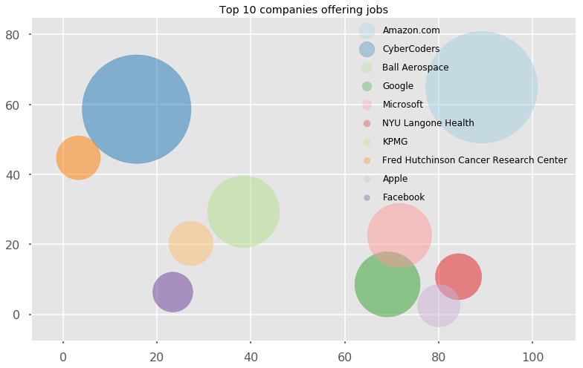
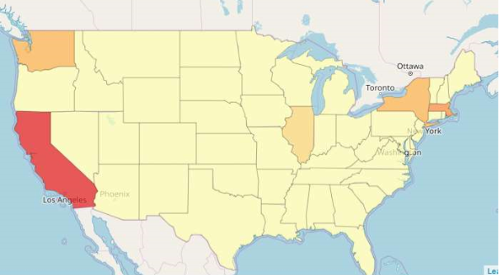
Different visualization styles We tried different graph styles and all of them tell a different story from the same data

Slide 24

Questions?

